Slide 1
Introduction
Human speech is one of the most natural ways to express oneself. We rely on it so much that we recognize its importance when we turn to other modes of communication, such as emails or text messages, where we frequently utilize emojis to express ourselves.
Emotions are subjective, and there is no common understanding on the kind of emotions we express. This is where speech emotion recognition comes into play, as it helps in the processing of speech and the classification of speech signals into emotions.

Slide 2
Problem Statement
The problem statement of emotion detection by voice recognition has a wide range of scenarios. It can occasionally be challenging to identify emotions from facial expressions and body language.
For example, speaking in front of an audience might make some people nervous. According to research, there are physical indicators of an individual's wellbeing during a public speech, such as an elevated heart rate and voice strain.
Another situation would be for those occupations, like airplane pilots, who would endanger their safety if they are not mentally prepared. This is where voice recognition for emotion detection comes in which helps to detect stress & other emotions.

Slide 3
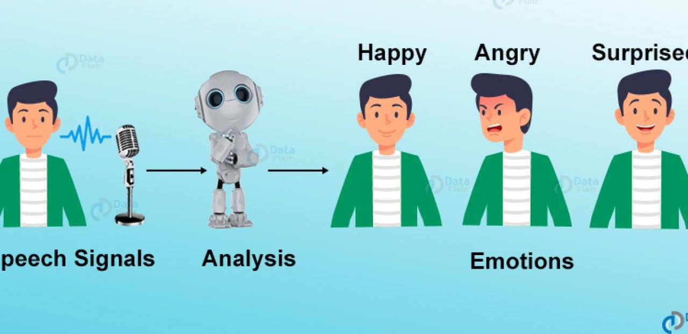
Proposed Solution
Speech Emotion Recognition (SER) will be the system used to identify the emotion of different audio samples. It would be a classification solution that categorizes an input sample (audio) into a few predefined emotions.
Speech Emotion Recognition (SER) solutions help teachers understand student emotions and provide personalized support in the classroom as well as evaluate individuals seeking for management jobs by studying their responses during audio or video interviews. This is to see if they have the confidence that makes them an ideal candidate.

Slide 4
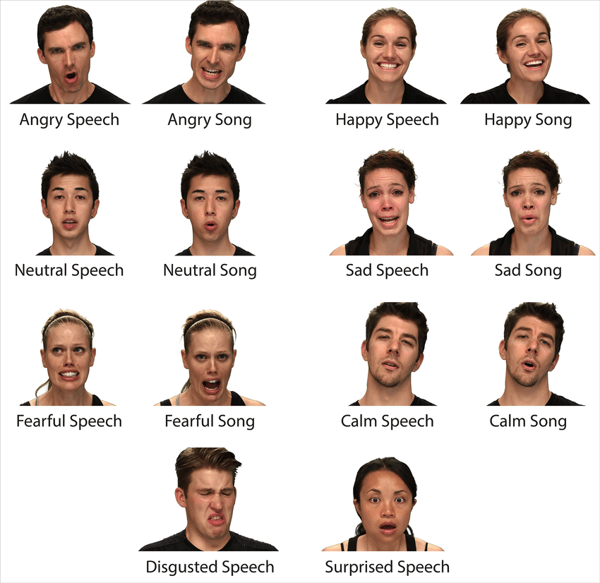
Dataset
The RAVDESS is a multimodal database of emotive speech and song that has been verified. The database is gender balanced, with 24 professional actors performing the same phrases in a neutral North American accent.
RAVDESS dataset is utilize for this project as it contains samples showing emotional states such as disgust, fear, anger, joy, surprise, sadness, and the neutral state.
RAVDESS Dataset Actors

Slide 5
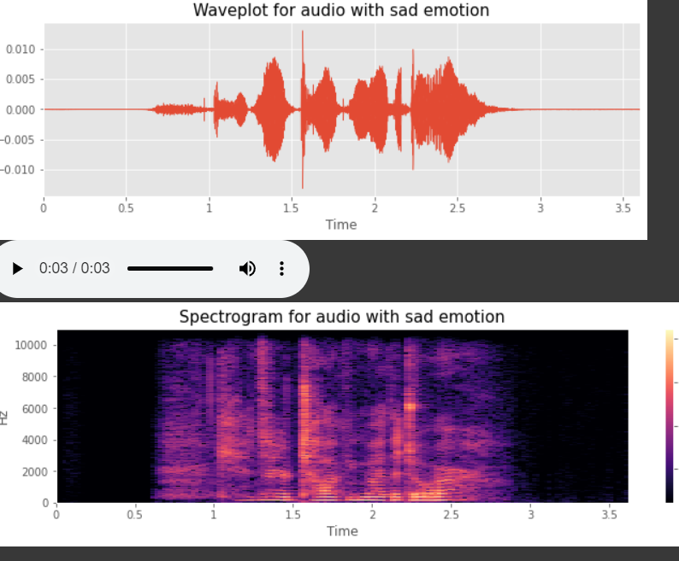
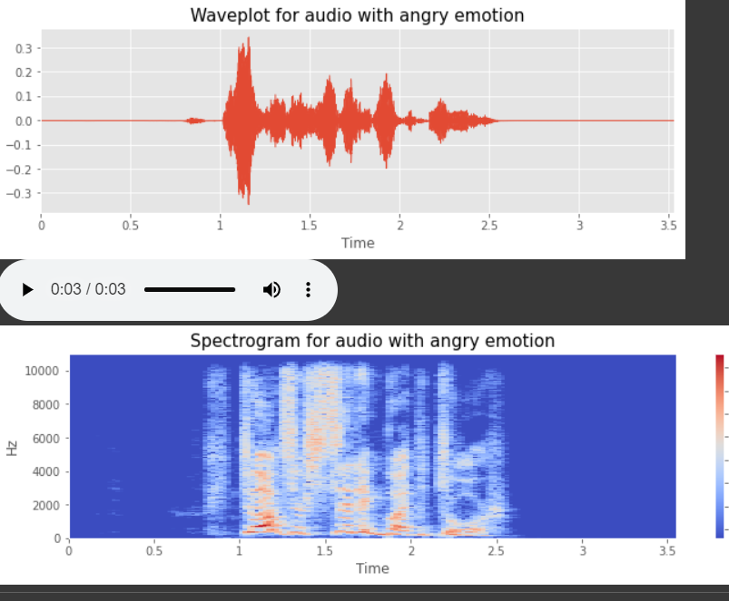
Data Exploration
The Waveplot was utilized to determine the loudness of the audio at any given time & a spectrogram is utilize to show a graphic display of the spectrum of frequencies of sound or other signals as they change over time.
These important features aid in the search for the key pattern that will allow us to differentiate between the various emotions, as different emotions include various frequencies.

Slide 6
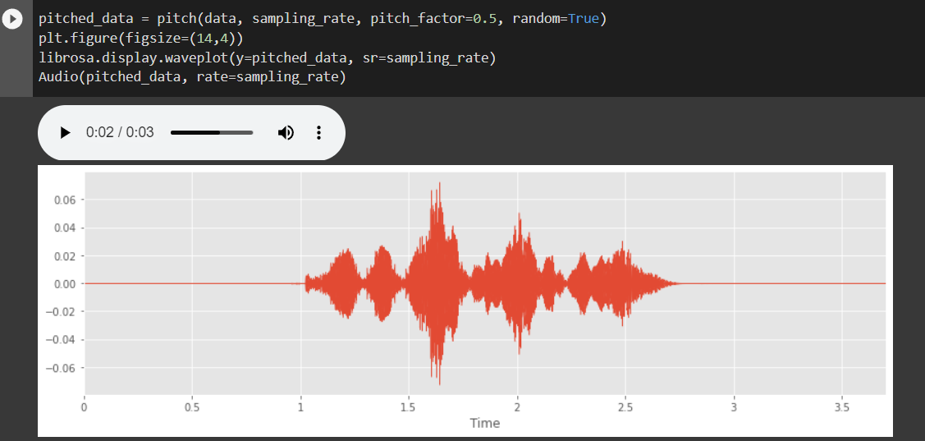
Data Augmentation
Data augmentation is a used for increasing the size and variety of the training set. This improves the model's robustness and performance by decreasing overfitting.
For this project, the techniques used for Data Augmentation are Noise Injection, Stretching, Shifting, and Pitching, which introduce random noise to the audio, exposing it to a larger variety of changes on the dataset.
e.g. Applying Pitch to Audio Data

Slide 7
Model Building
Loading the dataset, importing packages and libraries such as librosa, discovering insights for the model are all steps needed. The next stage would be features extractions and splitting it into training and testing sets produced.
After Data Preparation, CNN will be used to train the model while it allows input to run through a sequence of layers in a linear way, assisting the model in capturing dependencies in speech signals, which is crucial for successful speech recognition. Once completed, model evaluation will be used to calculate the accuracy of the model and it will be exported so it can be used for deployment in the application.

Slide 8
Speech-to-Text API
Speech-to-text APIs may be used to convert spoken language into written text, which can then be analyzed using emotion recognition algorithms to determine the emotional content of the speech.
The speech recognition library was imported which allows to add speech recognition capabilities to the web application, which would then be able to transcribe audio based on the provided audio file and provide a confidence score based on accuracy.

Slide 9
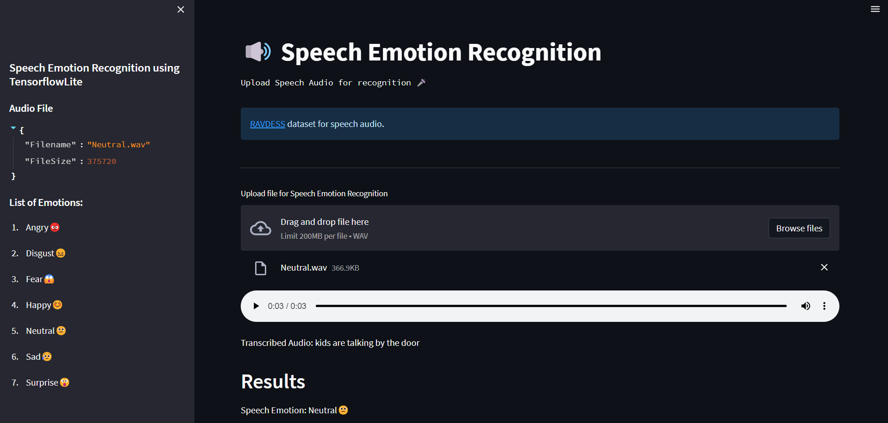
Deployment
The Web Application will operate on the Streamlit library alongside the loaded model using Tensorflow and the Speech to Text API.
The application will be utilising the upload of file function where audio samples are uploaded & show the result of the emotion based on the audio file which then transcribe the audio to text as well.
Web Application

Slide 10
Room For Improvements
The RAVDESS dataset presently contains just 24 performers, which may not reflect a wide range of dialects, emotions, and cultural origins. Increasing the variety of actors in the dataset may increase its overall accuracy and use.
There are now 1440 samples in the RAVDESS dataset, which may not be enough to train complicated deep learning models. Increased sample size may increase the accuracy of models trained on the dataset.
Apart from the 1440 samples, most of the audio data has the same phrases spoken, limiting the effectiveness of the speech to text API.

Slide 11
Conclusion
Using something like Streamlit web application was new, but it assisted me in building and deploying the models, which was a key element of this project, without having to worry about web development process.
Emotion detection by voice recognition aids in the analysis and recognition of emotions in spoken language. This technology may also be utilized in psychology and therapy to acquire insights into a person's emotional state, which can aid in diagnosis and treatment.
Overall, speech emotion recognition technology has the potential to increase empathy, comprehension, and personalization across a wide range of industries and applications.

